Slide 1
Case Study of Inventory Ingredient App
Renee Penland
April 25, 2023

Slide 2
Project overview
The product:
The ingredient inventory app tracks all sizes of ingredients and lists their purchase price and expiration date. The app can be used to order more supplies or track expenses. Reports can be run on the inventory data.
Project duration:
January, 2023 – April, 2023

Slide 3
Project overview
The problem:
Customer wants an inventory app to track ingredients used at a sandwich shop.
The goal:
The goal of this project is to inventory ingredients for cost analysis, product ordering and preparing reports on the inventory data.

Slide 4
Project overview
Renee Penland’s roles:
UX Designer and UX Resarcher
Responsibilities:
User research, wireframing, prototyping, graphics, testing, iterations, documentation, etc.

Slide 5
User research
Personas
Problem statements
User journey maps
Understanding
the user

Slide 6
User research: summary
Interviewed employees about an ingredient inventory app for a sandwich shop. Was told they needed a better way to track ingredients so they would not run out of supplies. They need the ability to track expenses and increase prices of their sandwiches when the ingredient prices called for a price adjustment. They wanted the ability to do reports within the inventory app.

Slide 7
User research: pain points
1
2
3
4
Pain point
Pain point
Pain point
Pain point
Track ingredients inventory to maintain supplies and not run out.
Track expenses in order to increase sandwich prices and apply them to the customers.
Run reports on price changes or low inventory to help employees maintain maximum efficiency.
Track expiration dates of supplies so they can be discarded in a timely manner.

Slide 8
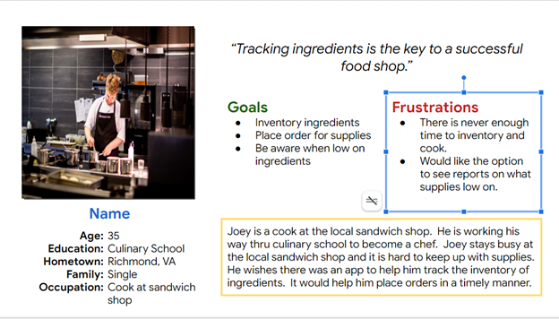
Persona: Joey Short
Problem statement:
Joey Short, is a cook at a sandwich shop,
who needs an efficient way to inventory ingredients, to ensure he has enough supplies on hand to make sandwiches.

Slide 9
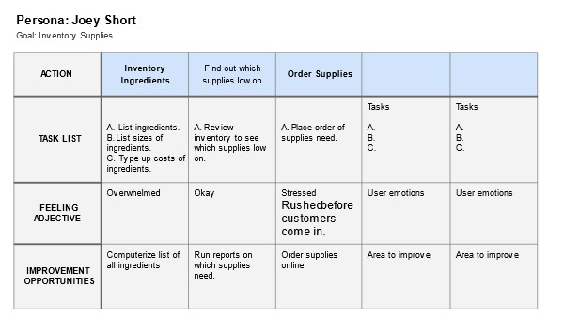
User journey map
Goal is to make inventorying ingredients as easy as possible. Mapping Joey’s user journery identified a computerized app for inventorying ingredients would be helpful.
Image of user journey map

Slide 10
Paper wireframes
Digital wireframes
Low-fidelity prototype
Usability studies
Starting
the design

Slide 11
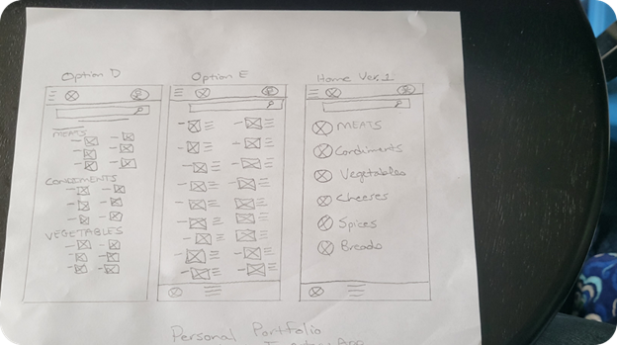
Paper wireframes
Example of paper wireframes for the Home Screen. Different configurations of the main menu items were tried. Finally decided to use the Home Screen version 1 on the right side of the screen.
Image of paper wireframes including five different versions of the same screen and one image of the new, refined version

Slide 12
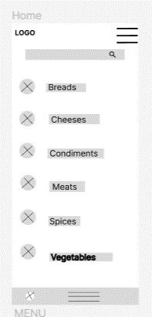
Digital wireframes
Search bar added so a user could look up a specific ingredient as needed.
Search bar and menu option given for navigation. Listed ingredient categories to make it easier for people to find items. Will add images of the categories to make it visually easier to identify ingredients.
Insert first wireframe example that demonstrates design thinking aligned with user research
Ingredient categories listed to make it easier to locate an item.

Slide 13
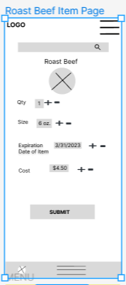
Digital wireframes
Individual item page for roast beef. Contains quantity, size, expiration date, and cost of the ingredient.
Individual item page for roast beef. This is where individual information for an ingredient would be updated.
Insert second wireframe example that demonstrates design thinking aligned with user research
Plus and minus sign used to update quantity, but there was also a text field to type into.

Slide 14
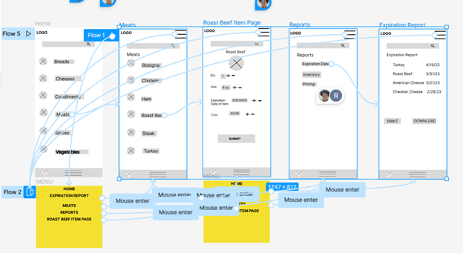
Low-fidelity prototype
Link to low-fidelity prototype:
https://www.figma.com/proto/k7t03m7bmF1bkZd31TILMv/Personal-Portfolio-Wireframes?node-id=1-2&scaling=scale-down&page-id=0%3A1&starting-point-node-id=1%3A2&show-proto-sidebar=1
User Flow- Meats, Roast Beef, Roast Beef Item Page, to Menu Page, Home.

Slide 15
Two rounds of usability studies were conducted on the ingredient inventory app.
Usability study: findings
Round 1 findings
Round 2 findings
1
Users were confused how to run an expiration report from roast beef item page.
1
Search icon is confused for zoom in icon. Needs to be changed.
2
Alphabetize menu categories for easier search capabilities.
2
Home icon was not wired in prototype to work.
3
Users confused when updating quantity because prototype didn’t work.
3
User found app easy to use.

Slide 16
Refining
the design
Mockups
High-fidelity prototype
Accessibility

Slide 17
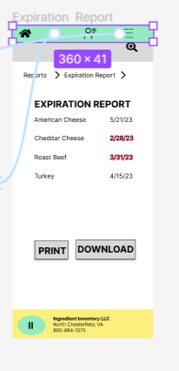
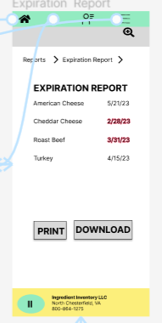
Mockups
Before usability study
After usability study
P0 Goal – Wire home icon so it functions and takes the user back to the home page.
Image of selected screen before usability study
Image of selected screen after usability study

Slide 18
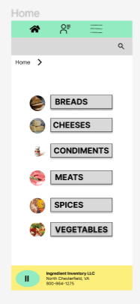
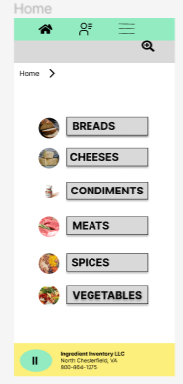
Mockups
Before usability study
After usability study
P1 Goal – The search bar icon has a plus inside it and users confuse it for a zoom button instead of a search bar button.
Image of selected screen before usability study
Image of selected screen after usability study

Slide 19
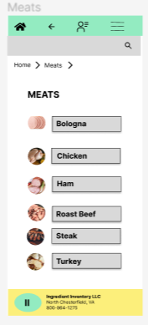
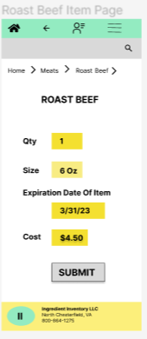
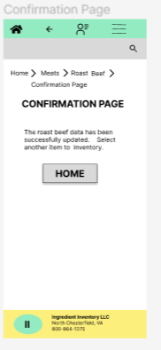
Mockups
Main mockup screen for display
Main mockup screen for display
Main mockup screen for display
Main mockup screen for display

Slide 20
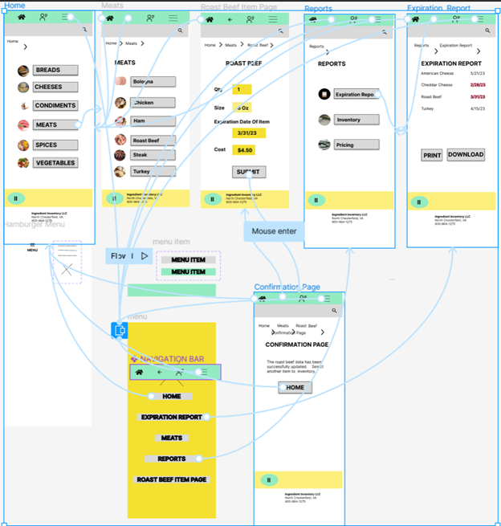
High-fidelity
prototype
Link to high-fidelity prototype:
https://www.figma.com/proto/k7t03m7bmF1bkZd31TILMv/Personal-Portfolio-Wireframes?node-id=300-187&scaling=min-zoom&page-id=300%3A186&starting-point-node-id=306%3A232
Screenshot of prototype with connections or prototype GIF

Slide 21
Accessibility considerations
1
2
3
Accessibility was a key factor in choosing the color palette. Yellow and green were used for the header and the footer. The buttons were left gray with black text because they were easier for color blind people to read. Other color combinations with green are more difficult to read.
Users are able to navigate thru the ingredient inventory app using several navigation methods. There is a home icon, a menu icon, and a back key. Therefore users can move forward or backward thru the app as they would like.
Button text is typed in bold, Inter typeface in either 24 or 20 px. This is a san seriff font. The spacing between the buttons and the font were chosen because they make the text easy to read.

Slide 22
Going forward
Takeaways
Next steps

Slide 23
Takeaways
Impact:
This case study was created for a Web Design class. It taught me the steps that go into creating a website. This case study will be in my portofolio until I learn the steps on how to code and create the app myself. There are only a few ingredient inventory apps out there according to my competitive audit.
What I learned:
I learned all the steps that go into making a website:
User Research
Wireframes
Graphic Design
Mockups
Testing
Iteration
Documentation
Sticker Sheets

Slide 24
Next steps
1
2
3
Add this case study to my portfolio to show what I learned in my web design classes in order to obtain a job.
I would keep this project in my files in case a need for an ingredient inventory app arises down the road. There are not too many of them out there that currently exist. I also do not have the skill set to code the actual website.
Once I have the skills to code the website, then I would create it as an example of my work.

Slide 25
Insert a few sentences summarizing the next steps you would take with this project and why. Feel free to organize next steps in a bullet point list.
Let’s connect!
If you would like to review more of Renee Penland’s work, please contact her at the information below.
Renee Penland
drp27249@email.vccs.edu
804-912-5445
www.linkedin.com/in/renee-Penland-2023

Slide 26
Thank you!

